Slide 1

Recommendation Systems
Cs 593 Final Project
Giri, Surya : 10475010
Jeevan, Anirudh :10475896
Panchal, Dhruvam :10475213
Ani

Slide 2



Meet the team
Giri, Surya
CS 593: A
10475010
Jeevan, Anirudh
CS 593: A
10475896
Panchal, Dhruvam
CS 593: A
10475213

Slide 3

Agenda
WHAT ARE RECOMMENDATION SYSTEMS?
TYPES OF RECOMMENDATION SYSTEMS
OUR RECOMMENDATION SYSTEMS:
RECOMMENDATION SYSTEM I
RECOMMENDATION SYSTEM II
CONCLUSIONS

Slide 4

What are recommendation systems?
Needs no introduction! Widely used in practically every entertainment media.
Lesser known Examples: Tinder, Facebook, Pinterest
Challenges:
Collecting metadata
Calculating new ratings based on previously known ratings
Measure of accuracy

Slide 5
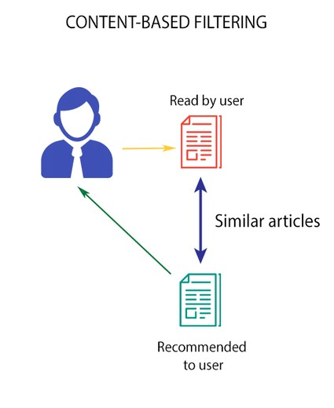
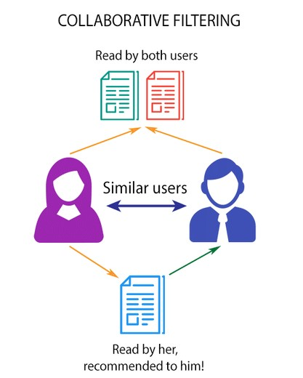
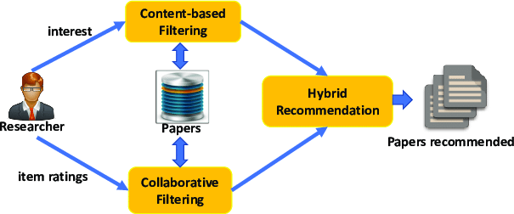
Types of recommendation systems
Content Based Filtering
Recommends content to users on the basis of content
Needs metadata to work
Does not require other users' data like likes and preferences
Collaborative Filtering
Recommends content to users on the basis of other users
Needs user reviews and ratings
Requires other user’s likes and preferences
Hybrid
Special Recommendation Systems
Combines results of both content filtering and collaborative filtering
Usually is made specific to task

Slide 6

Our recommendation systems
Let’s Dive In

Slide 7

Recommendation system i
Content based filtering

Slide 8
EXPLORATORY DATA ANALYSIS
The dataset contains TV shows and Movies from Netflix, and is constantly updated. Currently, after the mid-2021 update, it has over 8000 rows and 200M subscribers.
Link: Netflix Movies and TV Shows | Kaggle
Attributes: show_id, title, director, cast, country, date_added, release_year, rating, duration listed_in description, type, year_added, month_added; which are very good metadata.
Converted date to standard US date format.
We found that there are many more movies compared to tv shows, and number of movies added each year keeps on increasing compared to tv shows

Slide 9
Extracting key words with NLTK
RAKE short for Rapid Automatic Keyword Extraction algorithm, is a keyword extraction algorithm which tries to determine key phrases in a body of text
Has configurable word and sentence tokenizers and language based stop words
We used to it to comb through the dataset to extract prediction variables like cast, director and common key words
This needs to be done since those columns do not have the data in our required format. Thus, we extract them and ‘bag’ them in separate easily accessible lists

Slide 10
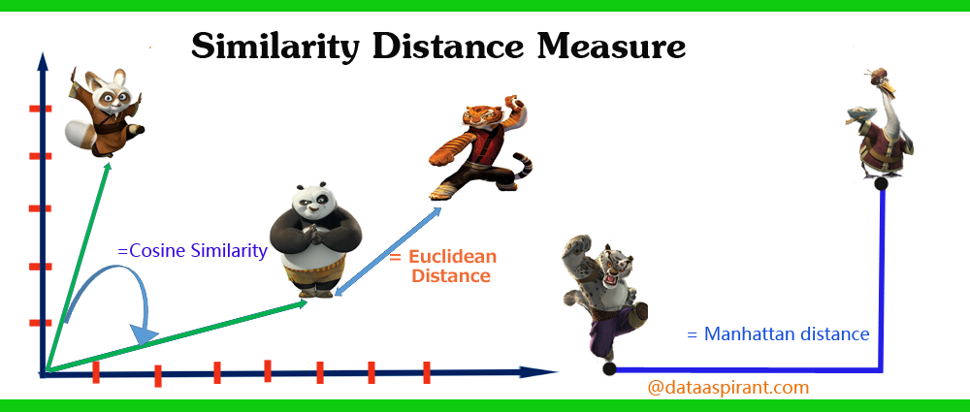
Calculating ‘similarity’
Cosine similarity is a metric used to measure how similar the documents are irrespective of their size
It measures the cosine of the angle between two vectors projected in a multi-dimensional space
Smaller the angle, more the similarity between two documents
Euclidean distance maybe higher because of the size

Slide 11
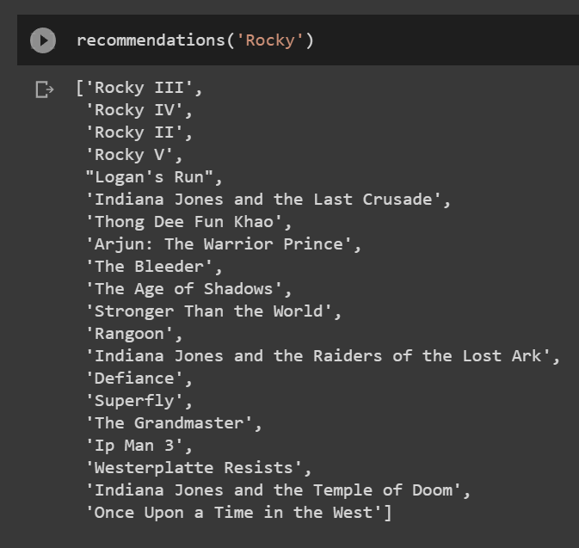
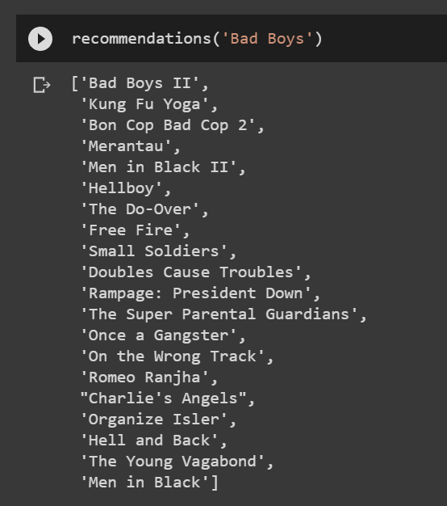
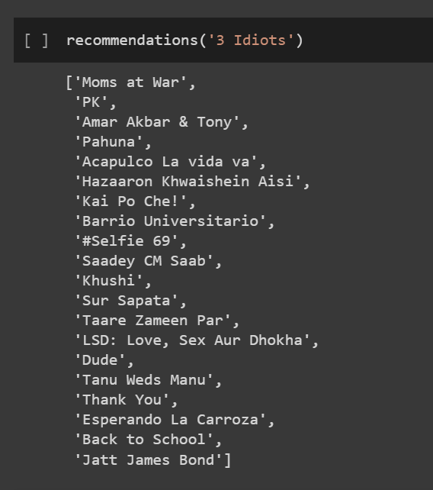
What does Content Filtering look like?
Sequels are on top
Ip Man 3 also notable
We get it.
Sequel is on top again
Has multiple other Will Smith movies
Similar action movies also show up, even in other languages
PK and Tare Zameen Par have the same lead actor (Amir Khan)
Tanu Weds Manu features one of prominent side characters(R. Madhavan)
Amar, Akbar & Tony is an excellent example of “same formula, different movie”

Slide 12
Recommendation system iI
Collaborative Filtering

Slide 13
EXPLORATORY DATA ANALYSIS
The dataset we are using for collaborative filtering is called The Movies Dataset. We are specifically using ‘ratings_small.csv’ out of the available files as we only need userId, movieId and ratings for a collaborative filtering prediction. It is a subset of 100,000 ratings from 700 users on 9,000 movies.
Link: The Movies Dataset | Kaggle
It has 4 columns: userId, movieId, rating & timestamp; and more than 100,000 rows, which is a good sample size for a prediction.
It has no missing values and hence no manipulation required.
All values of the prediction variable ‘rating’ are on a scale of 5, hence no standardization required.
Converting data factor into a Surprise dataset which has the format:
user ; item ; rating ; [timestamp]

Slide 14
Surprise?
The name SurPRISE (roughly :) ) stands for Simple Python Recommendation System Engine
Surprise is a Python scikit for building and analyzing recommender systems that deal with explicit rating data.
Users can use both built-in datasets (Movielens, Jester), and their own custom datasets.
Provide various ready-to-use prediction algorithms
Provide tools to evaluate, analyse and compare the algorithms’ performance.
RMSE as accuracy measure

Slide 15
ALGORITHMS USED

Slide 16
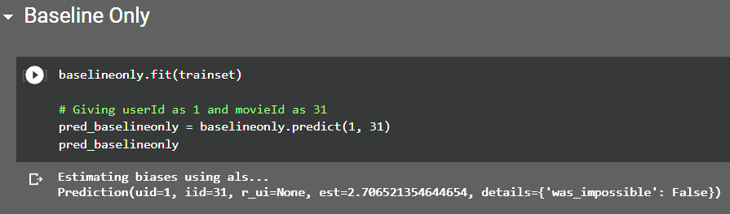
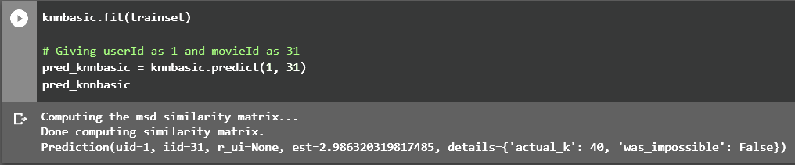

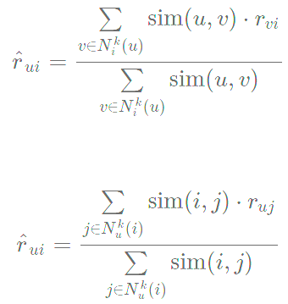
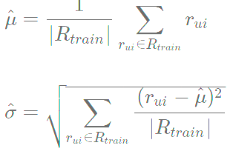
Baseline Only
Base k-NN
Algorithm predicting a random rating based on the distribution of the training set
MLE:
A basic collaborative filtering algorithm derived from k-NN
The prediction r^ui is set as:

Slide 17
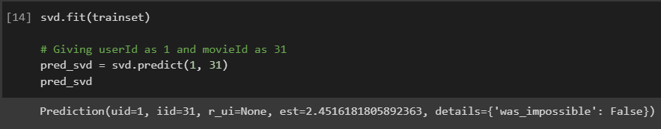
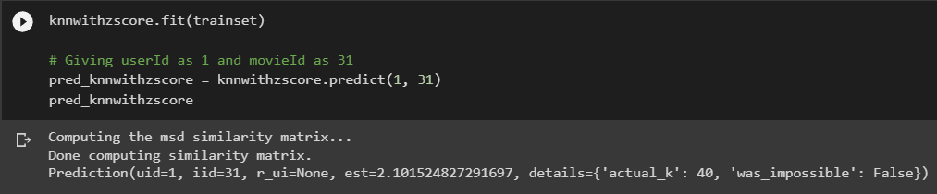

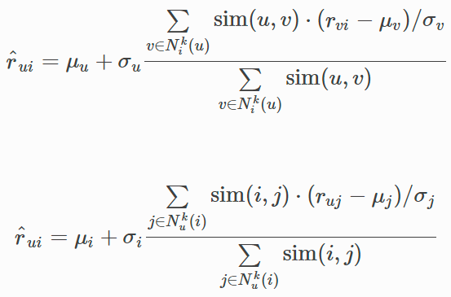

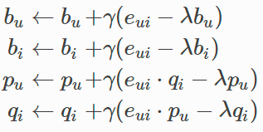
Singular Value Decomposition
K-NN with Z-Score
The famous SVD algorithm, as popularized by Simon Funk during the Netflix Prize
Prediction is given by:
Minimize the regularized squared error:
SGD:
A basic collaborative filtering algorithm, taking into account the z-score normalization of each user.
The prediction r^ui is set as:

Slide 18
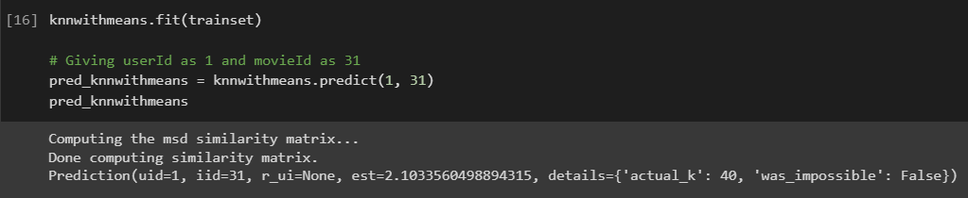
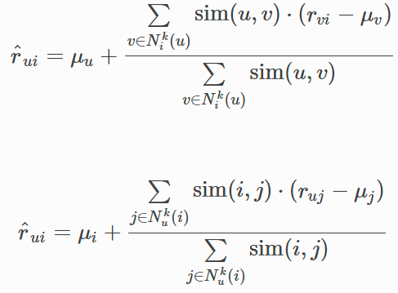
K-NN with Means
A basic collaborative filtering algorithm, taking into account the mean ratings of each user
The prediction r^ui is set as:

Slide 19

SUMMARY
OUR PREDICTIONS ARE GOOD
Both content filtering and collaborative filtering have given us decently accurate results.
THIS CAN BE FURTHER IMPROVED
A hybrid system could work, using LightFM, given a common dataset
CONTENT FILTERING IS ALSO ADHERING TO CHILDREN’S RECOMMENDATIONS
Searching for superhero PG-13 movies, model recommends other similar PG-13 superhero movies, but not all are strictly PG-13
COLLABORATIVE FILTERING NEEDS USER DATA
Collaborative filtering cannot work with missing data, and thus it requires sophisticated methods to handle it

Slide 20
THANK YOU
Giri, Surya
Jeevan, Anirudh
Panchal, Dhruvam
Professor: Mr. Khashayar Dehnad

